Slide 1
Dijkstra’s Shortest Path Algorithm
CS 330 Intro to the Design and Analysis of Algorithms
Lecture note
Sajedul Talukder

Slide 2
Shortest Path Algorithm
What is the Shortest Path Problem?
Is the shortest path problem well defined?
The Dijkstra's Algorithm for Shortest Path Problem.
Implementation Dijkstra's Algorithm

Slide 3
Shortest path problem
In an edge-weighted graph, the weight of an edge measures the cost of traveling that edge.
For example, in a graph representing a network of airports, the weights could represent: distance, cost or time.
Such a graph could be used to answer any of the following:
What is the fastest way to get from A to B?
Which route from A to B is the least expensive?
What is the shortest possible distance from A to B?
Each of these questions is an instance of the same problem:
The shortest path problem!

Slide 4
Shortest path problem
In an edge-weighted graph, the weight of an edge measures the cost of traveling that edge.
For example, in a graph representing a network of airports, the weights could represent: distance, cost or time.
Such a graph could be used to answer any of the following:
What is the fastest way to get from A to B?
Which route from A to B is the least expensive?
What is the shortest possible distance from A to B?
Each of these questions is an instance of the same problem:
The shortest path problem!

Slide 5
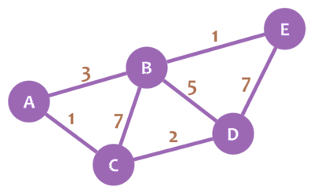
Is the shortest path problem well defined?
If all the edges in a graph have non-negative weights, then it is possible to find the shortest path from any two vertices.
For example, in the figure below, the shortest path from A to D is { A, C, D } with a total cost of 3.
Thus, the problem is well defined for a graph that contains non-negative weights.

Slide 6
Single-Source Shortest Path Problem
Single-Source Shortest Path Problem - The problem of finding shortest paths from a source vertex v to all other vertices in the graph.
A
6
B
5
C
1
2
2
5
E
D
1

Slide 7
Dijkstra's algorithm
Dijkstra's algorithm - is a solution to the single-source shortest path problem in graph theory.
Works on both directed and undirected graphs. However, all edges must have nonnegative weights.
Approach: Greedy (visit the closest node to the already visited tree at any instance)
Input: Weighted graph G={E,V} and source vertex v∈V, such that all edge weights are nonnegative
Output: Lengths of shortest paths (or the shortest paths themselves) from a given source vertex v∈V to all other vertices

Slide 8
Dijkstra's algorithm
Follow the following steps:
Take 2 lists: unvisited and visited and add all vertices to unvisited
Extract min. distance unvisited vertex
Add extracted vertex to visited list
Update neighbors distance if smaller

Slide 9
Dijkstra's algorithm - Example
Extract min. distance unvisited vertex
Add extracted vertex to visited list
Update neighbors distance if smaller
A
6
Vertex | Shortest distance from A | Previous vertex
A
B
C
D
E
B
5
C
1
2
2
5
E
D
1
Visited = [ ]
Unvisited = [ ]

Slide 10
Dijkstra's algorithm - Example
Extract min. distance unvisited vertex
Add extracted vertex to visited list
Update neighbors distance if smaller
A
6
Vertex | Shortest distance from A | Previous vertex
A | 0
B | 3 | D
C | 7 | E
D | 1 | A
E | 2 | D
B
5
C
1
2
2
5
E
D
1
Visited = [ A, D, E, B, C ]
Unvisited = [ ]

Slide 11
Dijkstra's algorithm - Pseudocode
dist[s] ←0 (distance to source vertex is zero) for all v ∈ V–{s} do dist[v] ←∞ (set all other distances to infinity) S←∅ (S, the set of visited vertices is initially empty) Q←V (Q, the unvisited priority queue initially contains all vertices) while Q ≠ ∅ (while the priority queue is not empty) do u ← mindistance(Q, dist) (select the element of Q with the min. distance) S←S∪{u} (add u to list of visited vertices) for all v ∈ neighbors[u] do if dist[v] > dist[u] + w(u, v) (if new shortest path found) then d[v] ←d[u] + w(u, v) (set new value of shortest path)
(if desired, add traceback previous vertex)
return dist

Slide 12
Dijkstra's algorithm - Complexity
The worst-case runtime of Dijkstra’s is O(|E| + |V| log|V|), where E and V are the edge and node set, respectively.
This is because we check each edge of the graph in the traversal, requiring O(|E|) time.
We must also pull out each node from the priority queue, where each extract operation takes O(log|V|) time.
So the total time is O(|E| + |V| log|V|).

Slide 13
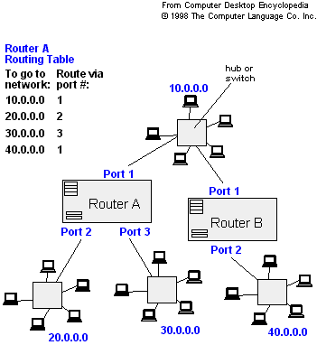
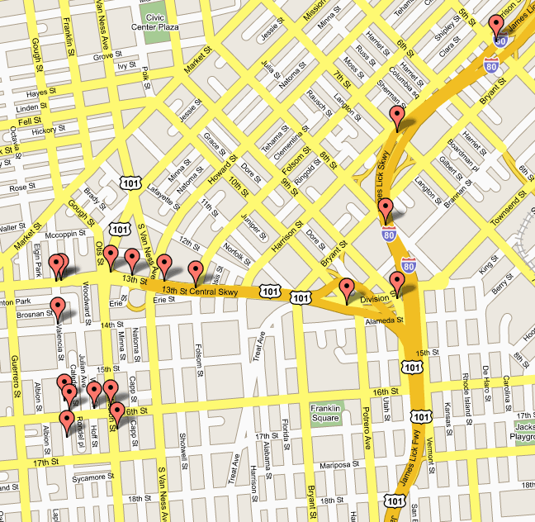
Applications of Dijkstra's Algorithm
- Traffic Information Systems are most prominent use
- Mapping (Map Quest, Google Maps)
- Routing Systems

Slide 14
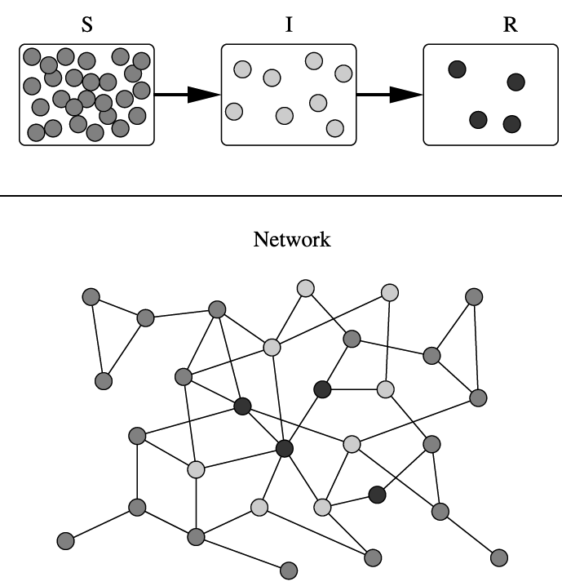
Applications of Dijkstra's Algorithm
One particularly relevant this week: epidemiology
Scientists may use networks to model the spread of infectious diseases and design prevention and response strategies. (Covid-19?)
Vertices represent individuals, and edges their possible contacts. It is useful to calculate how a particular individual is connected to others.
Knowing the shortest path lengths to other individuals can be a relevant indicator of the potential of a particular individual to infect others.

